Slide 1

“It’s Hard to Ask” Examining decision-making amongst end-stage renal disease patients considering asking friends and family for a kidney
Merryn Jones
RGON, PG Dip NS

Slide 2
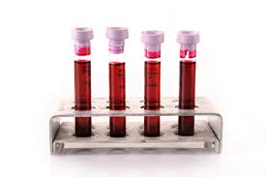
Background
Living Kidney Donor (LKD) Transplant Coordinator at Hawkes Bay District Health Board (HBDHB)
Patients may approach some family members, and not others, based on preconceptions
Some patients may not ask at all
Notes:
My name is Merryn, and I work as a living kidney donor corrdinator at HBDHB in NZ. I manage donor workup through to transplant, but I also talk with recipients to help them to identify potential donors and take the first steps to recruit. Until recently I also worked as a haemodialysis nurse.
Patients often make assumptions about who would, or would not, be a suitable donor within family and friends. Or they have set ideas about who will give to them, and ignore others that could be worked up. Or they don’t ask at all.

Slide 3
Is asking, or not asking, a problem?
25 patients listed as eligible on HBDHB
deceased donor list (DDL)
20 had living kidney donors being worked up
Problem: 20% of transplant eligible patients are potentially missing out on planned, matched kidney donation
What was happening with the 5 patients who
had no LKD donors being worked up?
Why did they not have donors?
Who isn’t being asked? Who are we not reaching?
Notes:
My role is funded from the MOH for 3 years to the DHB with an aim to increase living kidney donor rates. My task is to generate more LKDonations. When I took on the role, I looked at our patients in every sector of our renal service from 120 pre-dialysis patients to those on 150 plus HD and PD both in centre and in the community. I also took a look at who was on the DDL. The DDL criteria gets harder and harder as the numbers of people requiring kidneys grows. So if you are “well enough” to be accepted on the list, you are obviously a good transplant candidate. Therefore if you had people who could be worked up for you as a living donor, you would have 2 opportunities to receive a kidney – from a living or a deceased donor – 2 slices of the pie, so to speak.

Slide 4

Research Aims
To gain a better understanding of patient decision-making process, motivations for choosing or declining to ask others for a kidney
To facilitate better patient support and resources
Improve the likelihood of positive responses to personal requests for kidneys and other organs
Notes:
So thinking about this issue, I wanted to explore the lived experience of asking for a kidney, or not as the case may be, so that as a service, at a national and regional level, we might be able to better understand some of the barriers to asking, and provide more supports in this area. Ultimately, with a view to improving living kidney donations.

Slide 5

What I wanted to know…
Who did the patient ask, and why?
Who did they exclude, and why?
How did the patient approach the request, and
What were their reasons for asking in this way?
Was there anything else they could have done that might have been helpful?
Notes:
So what I wanted to know was who was being asked, and why, and just as important, who was NOT being asked. The who, what, how, when and why questions. This was suited to qualitative descriptive methodology, so open ended questions were asked. The interview questions looked more like “Had they ever asked family or friends for a kidney?” and then asked them to describe their experience of this.

Slide 6

Research Methods / Sample
Qualitative descriptive
Ethics/DHB/Maori health approval
15 interviews completed
Mix of treatment modalities, ethnicity, gender and age
8 patients were on the DDL alone
3 were on DDL and also had LKD donors being worked up, and
4 were LKD only
5 pre-dialysis and 10 dialysis patients (7 x HD & 3 PD)
5 women / 10 men
Notes:
Ethics approval from HDEC, and also DHB and Maori Health approval were given. 15 participants were interviewed, aged from 23 years to 68 years old. Treatment modalities were varied, some on haemodialysis, some on peritoneal dialysis and some predialysis. Likewise there was a mix of DDL, DDL and LKD, and LKD alone.

Slide 7
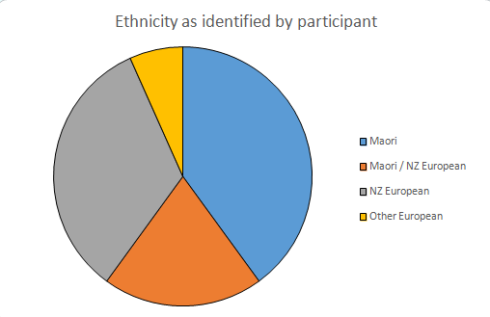
6 participants Maori, 3 Maori/NZ Euro, 5 NZ European, 1 other European
In Hawkes Bay 69% of renal population identifies as Maori (ANZDATA 2014)

Slide 8
Main themes and subthemes
Will ask
Direct recruitment
Indirect recruitment
Won’t ask
Will accept an offer
Won’t accept an offer
“How can I ask for a kidney, when I can’t even ask to borrow a chainsaw?”
Notes:
5 main themes, with subthemes.
1. Will ask
Younger participants often had parents or other relatives actively recruiting for them. The use of tools such as Facebook was also mentioned by several participants, while others had not thought of using social media. Using social media was effective for people to tell their story and see if anyone offered, rather than ask for a kidney directly.
2. Won’t ask
Won’t ask and won’t accept an offer
Won’t accept offers
Cultural or traditional values
Philosophical beliefs: Acceptance of how things are; Not wanting loved ones to donate; The anonymity of a deceased kidney
Won’t ask but will accept an offer
I saw a lot of sadness in people who had told their story and were waiting for offers. There was a fair bit of hurt that was alluded to. For those who had received offers, whether they were taken up or not, they were really grateful. They felt the love.

Slide 9
Main themes and subthemes cont’d
Offers
Waiting for offers from family and friends
What it feels like to have people offer
“I can't take one from them”
“They don’t offer, and I don’t ask”

Slide 10
Main themes and subthemes cont’d
Barriers to asking
Managing risks – surgical, ongoing, relationship
“I don’t look sick”
Limited recruitment opportunities
Predetermining suitability
Preconceptions as a barrier – misinformation
Waiting for a deceased kidney donation – availability vs legislation
“Who would I ask - all my whanau are sick”
Notes:
Limited recruitment: Poor health in whanau or Pasifika families often as a result of genetic pre-dispositions, eg diabetes, gout, HTN. and high likelihood of discovering problems during screening.
5 x PKD families currently on our books
Small recruit choice also seen in 2 patients who were European: 1 moved to NZ with moderate renal failure and the other is a 1st generation Nzer with small family. In this case a small pool and a small net.
Managing risks: Many participants worried about the health, financial burden giving a kidney would place on their loved ones. They also worried that asking for a kidney would affect the relationship. If the donor declined, it could be awkward, or if the kidney failed after transplant, they might have jeopardised the health of the donor unduly. Donor might get ‘scared’ about workup
Feeling a responsibility towards the person who gives you a kidney
Concerns re: obligations to donor post-transplant
Misinformation: patients talk in the dialysis waiting room. Or they have family members who have been on dialysis or had a transplant years ago, and it failed. And it was because so-and-so smoked weed before they donated, or the surgeon cut the ureter too short. Or they might think that because they are not a compatible blood group, or they are not related, that someone can’t give to them.

Slide 11
Thematic model
Notes:
So what does this look like as a thematic or conceptual model?

Slide 12
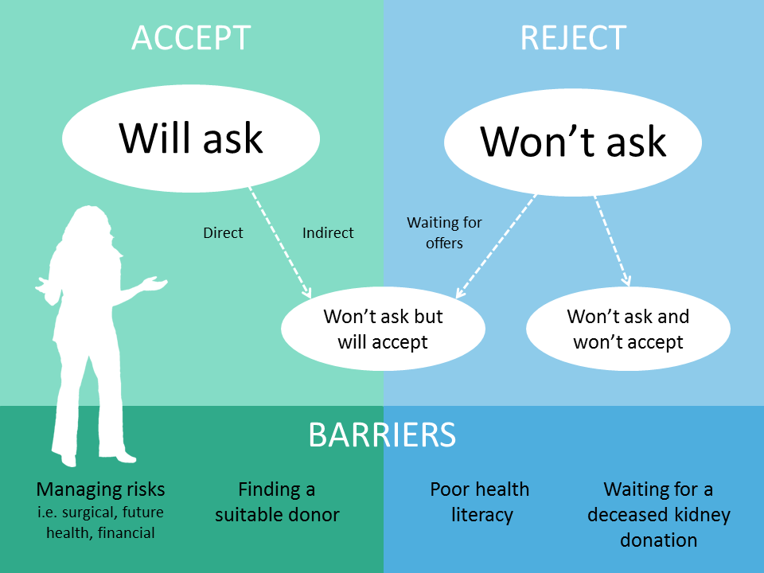

Slide 13
Results
Being expected to recruit donors for LKD is a barrier in itself
Most recipients desired more support
Recipients concerned for health & wellbeing of loved ones, above their own need
Some have limited health literacy
Some have poor self-efficacy
Many Maori favoured a whanau approach to recruitment

Slide 14

How might we help our patients to navigate these barriers?

Slide 15
Discussion – Recipient support
Psychological support :
Develop screening tool - assess recipient’s emotional wellbeing and commitment to transplant journey before approaching potential donors
Build confidence / improve self-efficacy
Addressing anxiety and stress
Notes:
Almost all participants in this study needed more support in order to be able to approach potential donors. Some were distressed at not being able to find a suitable donor. Others were distressed thinking they might cause harm to a loved one by accepting a kidney. Counselling, cultural and spiritual support should be available to recipients.
It is my opinion that psychosocial support should be routinely offered to all recipients. Psychosocial support should ideally happen before the patient has approached any potential donor, addressing any concerns such as self-advocacy, reciprocity, and relationship management, as well as providing skilled counselling for depression, negative quality of life or employment worries, and distress that may arise as the result of being diagnosed with a chronic, life-limiting disease.

Slide 16

Addressing anxiety and stress
Reciprocity – How do you thank/repay someone? Kidney donation is too big a gesture to be considered a gift.
Relationship management – Not wanting to cause harm, or future risks; financial burden; feeling obligated to donor.
Fear of asking and being rejected
Fear of kidney transplant failing and feeling responsible
Feeling that donation should be voluntary
Waiting for offers - stressful
Notes:
When considering whether to approach someone to ask for a kidney, participants were not motivated by thoughts of improved health for themselves. Participants were willing to deny themselves improved health outcomes in order to avoid feeling obligation for a ‘gift’ that could not be reciprocated, or guilt should the kidney be rejected.

Slide 17

Discussion – Recipient support
Health literacy:
Develop templates/tools around possible approaches
Recipient education re: transplant process – preparedness for questions from family/friends
Education around what makes for a suitable donor
Help with identifying possible donors
Peer support for recipients
Notes:
Patients felt that having the right information to be able to successfully recruit is paramount, and that having information was essential in order to be prepared to answer questions as they approached others to ask for a kidney.
For those who identify poor health literacy or communication barriers, a tailored support plan should be developed in partnership with the patient, including an action plan that may address who the patient might ask, how they might approach the subject, and what they might say.
Coaching and support in the form of role play should also be offered, renal health professionals practising the patient’s approach and rehearsing different ways to start a conversation about transplant.
With the increasing use of social media sites such as Facebook, some patients and their families in this study are turning to such sites in an attempt to recruit donors. Sample social media templates sharing the patient’s story and providing information about how to make contact with the patient’s donor coordinator should be developed in a variety of languages to be customised according to the patient’s needs.

Slide 18

Discussion – Recipient support
Cultural support
Involve whanau in transplant decision-making and care
Accept that for some Maori recipients LKD may never be their worldview
Often limited recruitment opportunities within whanau – therefore Maori might always have a higher DDL vs LKD uptake
Recipient might be pro-transplant, but have whanau disapproval
Engage with Maori Health / Kaumatua groups to
discuss transplant in context of cultural need
Foster transplant champions within Iwi groups
as a voice for change
Notes:
Involving whanau in decision-making and treatment planning, along with Maori health providers or Kaitakawaenga attached to the Renal Service, helps support those who struggle with the emotional, cultural and spiritual transition to adapting to life with ESRF, and the need for a transplant.
Additionally, involving Maori community leaders in generating conversations about transplant, both at a local level and national level, might support those who struggle with traditional Maori attitudes to transplant in a nation where Maori are disproportionately affected by renal disease. Using Maori champions in media campaigns will also generate whanau, and community, discussion about transplant.
Many of the participants in this study commented on Jonah Lomu getting a transplant. He was a NZ rubgy hero, and a Tongan. Seeing Jonah receiving a kidney made them feel more positive towards transplant.
Peer to peer support may also provides support for recipients, in the form of empathy, practical or cultural support, reassurance and hope as the patient talks with someone who has been a kidney recipient

Slide 19
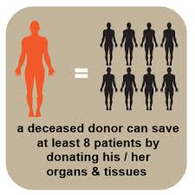
Deceased organ donation
For patients with limited recruitment opportunities, deceased kidney donation fulfils a need
Poor understanding of the circumstances whereby organs could be harvested
Education needed re: procurement of deceased organs in the event of accidental death or brain injury
Campaigns should:
encourage people to talk with loved ones about their wishes to donate
raise awareness of the need
Campaigns that get people talking about organ donation in general, should improve rates of both LKD and deceased donation in New Zealand.
Notes:
Many participants in this study voiced frustration at the low numbers of deceased kidneys available. But they also demonstrated a poor understanding of the limited circumstances in which organs can be procured in the event of death, and more work needs to be done to educate the public. Campaigns that raise awareness of the need for organs, or that encourage people to talk with their families about their wishes to donate in the event of death, are important for keeping the donation topic alive.
The use of Intensive Care champions in organ donation has seen a rise in the rates of deceased organ donation. Greater support for this initiative could be provided to each hospital in New Zealand.
While we all desire an increase in living kidney donation rates we mustn’t ignore the recipients desire to protect their friends and family from perceived potential health risks, and also protecting valued relationships. Appealing to improved health outcomes alone is not enough of a motivating factor to override the value that recipients place on the relationship with the donor or the donor’s health.

Slide 20

Health professionals
Should include a transplant conversation at each renal clinic visit with eligible patients
Note transplant pathway/treatment options in all clinical letters copied to GP/Patient
Opinions & attitudes influence uptake of LKD
A positive culture between health professionals leads to congruent messages being relayed to the patient
GPs need renal education, ensuring they have information on best practice and are aware of how early referral and transplant benefits their patients
Notes:
Health professionals should revisit the transplant conversation during each clinical encounter, in order to discern if there are any barriers to recruiting living donors. Patients who indicate early on that they would not accept a living kidney donation, should be followed up sensitively in later consultations to reinforce that, should they have a change of heart as sometimes happens at different times on this journey, or if their circumstances change, the door has not closed.
During clinical appointments, the renal health professional should discuss treatment modality and transplant pathway with the patient, ensuring this information is updated on all clinical letters to both patient and their GP. Educating primary healthcare providers about the benefits of transplant and early referral to renal services, as well as upskilling health professionals working in smaller referring centres, helps ensure clinicians have current/best practice information.
Gordon’s (2011) study demonstrated that transplant professionals’ opinions and attitudes influenced the uptake of living kidney donations. She found that positive opinions lead to positive results, while Martin (2013) stated that talking about transplant generally results in higher transplant numbers. These statements do not solely relate to patients and their families, but highlight the need for positive media stories about organ donation, and also the need for health professionals to communicate similar positive messages.
Conversations regarding positive outcomes for patients between transplanting centres, renal service staff, general practitioners and community health workers are also important, as a positive culture between health professionals leads to congruent messages being relayed to the patient.

Slide 21
Potential practice and delivery changes
Shared decision making
Improved health literacy
Early referral to renal services
Increased conversations about transplant
Psychosocial screening and support
Media campaigns
Involve whanau in decision-making
“Kidney disease is quiet”
Notes:
Improve health literacy and psychological support for recipients
Focus on shared decision-making
Involve whanau in treatment decision-making – improved outcomes
Early referral to DHB renal services with early medical intervention & patient education can delay progression of ESRD – educating primary care health providers
Provide meaningful stats to non-renal health professionals, so they understand the benefits of LKD
Positive use of transplant stories through media / health education in community
Campaigns that get people talking about transplant will influence rates of transplant
A few commented on the fact that cancer and heart disease get all the media attention.

Slide 22





Notes:
And if we support our patients to traverse some of the barriers to approaching others for a kidney, then hopefully they will triumph. Thanks to the RSA for hosting this conference, to Kidney Health NZ and Baxter Healthcare for their support in getting me to this conference, and thanks also to the NZ Nursing Education & Research Foundation for the scholarship I received at the start of this research. Are there any questions?

